Slide 1

Code basics – Resume challenge
October Month – Presented By : Rajesh Kumar

Slide 2

Company’s Background
AtliQ Mart

Slide 3
Company’s Background
AtliQ Mart
FMCG Manufacturer
Gujarat, India.

Slide 4
Company’s Background
AtliQ Mart
FMCG Manufacturer
Gujarat, India.

Slide 5
Company’s Background
AtliQ Mart
FMCG Manufacturer
Gujarat, India.
Surat
Vadodra
Ahmedabad

Slide 6
Problem Statement
Few key customers didn’t renew their annual contract due to service issue
Suspected Reasons
Late delivery
Not delivering in Full

Slide 7
Expectation
Clear understanding of key metrics
on-time delivery (OT%)
In-full delivery (IF%)
OnTime in full (OTIF %)
Line Fill Rate (LIFR%)
Volume Fill Rate (VOFR%)

Slide 8
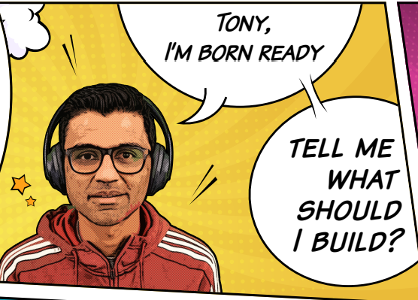
Who Am I ??
Peter Pandey
Junior Data Analyst – Supply chain Team

Slide 9
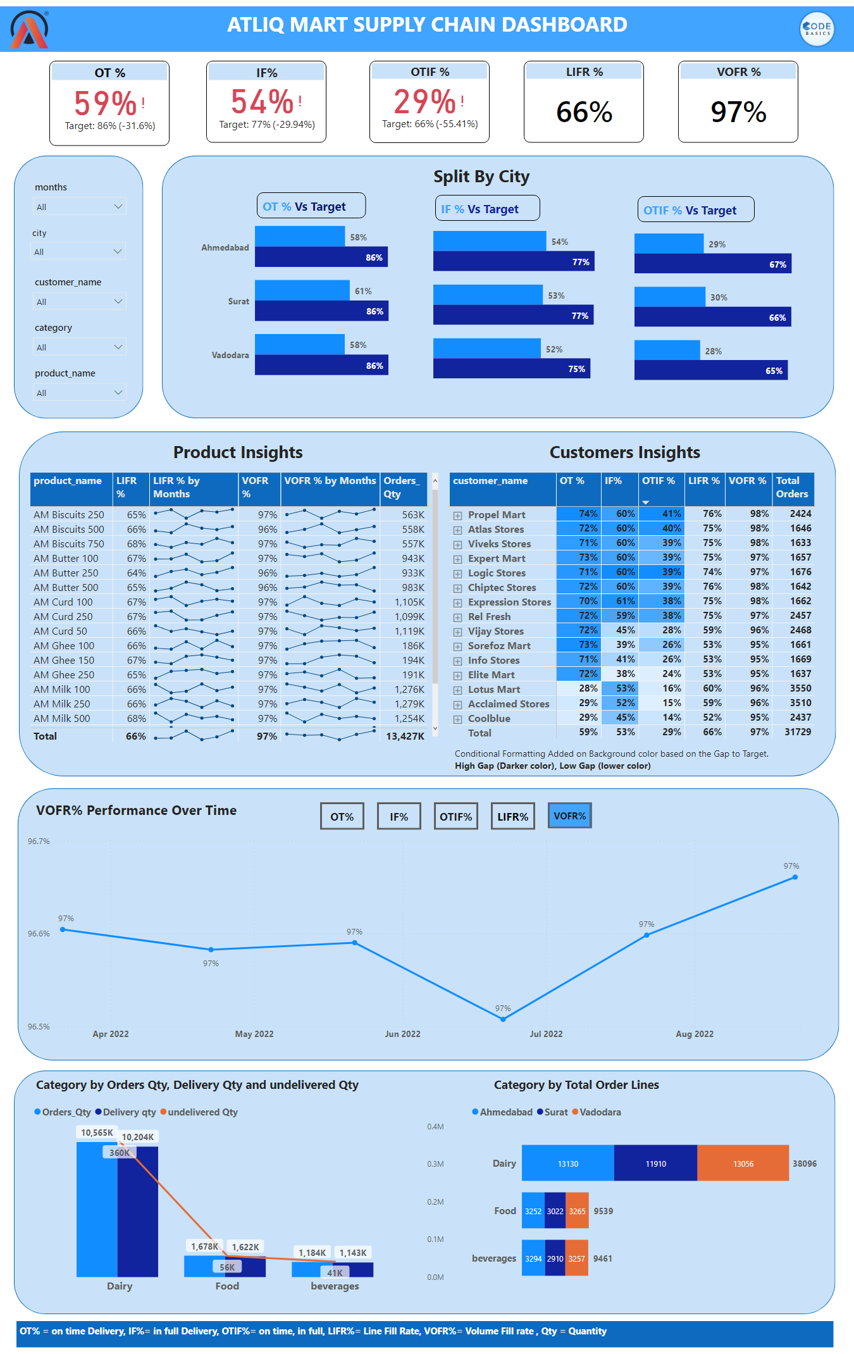
Page 1
Dashboard Design
Notes:
Split by Customers
No alt text provided
Slicer
No alt text provided
shape
No alt text provided
slicer
No alt text provided
slicer
No alt text provided
months
No alt text provided
textbox
No alt text provided
textbox
No alt text provided
image
No alt text provided
Product Insights
No alt text provided
shape
No alt text provided
actionButton
No alt text provided
actionButton
No alt text provided
actionButton
No alt text provided
actionButton
No alt text provided
actionButton
No alt text provided
Split by Cities
No alt text provided
textbox
No alt text provided
clusteredBarChart
No alt text provided
textbox
No alt text provided
Split by Cities
No alt text provided
Text box title
No alt text provided
textbox
No alt text provided
shape
No alt text provided
OT %
No alt text provided
IF%
No alt text provided
OTIF %
No alt text provided
LIFR %
No alt text provided
VOFR %
No alt text provided
shape
No alt text provided
textbox
No alt text provided
textbox
No alt text provided
slicer
No alt text provided
textbox
No alt text provided
Orders Qty, Delivery Qty and undelivered Qty by product name
No alt text provided
shape
No alt text provided
textbox
No alt text provided
textbox
No alt text provided
textbox
No alt text provided
VOFR TITLE
No alt text provided
textbox
No alt text provided
Total Orders by City, Category
No alt text provided
lineChart
No alt text provided
shape
No alt text provided
shape
No alt text provided
shape
No alt text provided
shape
No alt text provided
shape
No alt text provided
shape
No alt text provided
lineChart
No alt text provided
lineChart
No alt text provided
lineChart
No alt text provided
lineChart
No alt text provided
textbox
No alt text provided
textbox
No alt text provided
image
No alt text provided

Slide 10
Some Major Insights
➜ AtliQ mart has total orders of on time in full delivery(OTIF%) is 29% in all cities.
➜There is huge gap between the Key metrics (OT%, IF%, OTIF%) and target.
➜ LIFR 66% of all products and VOFR% is 97%.
➜AM Milk ,AM Curd, AM Butter are most selling products.
➜ The Most Ordering customers are Lotus Mart, Acclaimed stores as well as most delayed the delivery of the products on time.
➜There is a huge gap in IF% for most of the customers. Is it because of less production.

